Slide 1
How to estimate the Direct-to-Total Labor Ratio using U.S. Annual Survey of Manufactures/Economic Census
Identify the Industry Code based on the Supplier’s Business and Product
Step 2
Record the values of Annual payroll and Production workers annual wages
Step 4
Calculate the Direct-to-Total Labor ratio for the industry
Step 1
Obtain the latest available Manufacturing Data from the US Bureau of Census for the industry of interest
Step 3

Slide 2
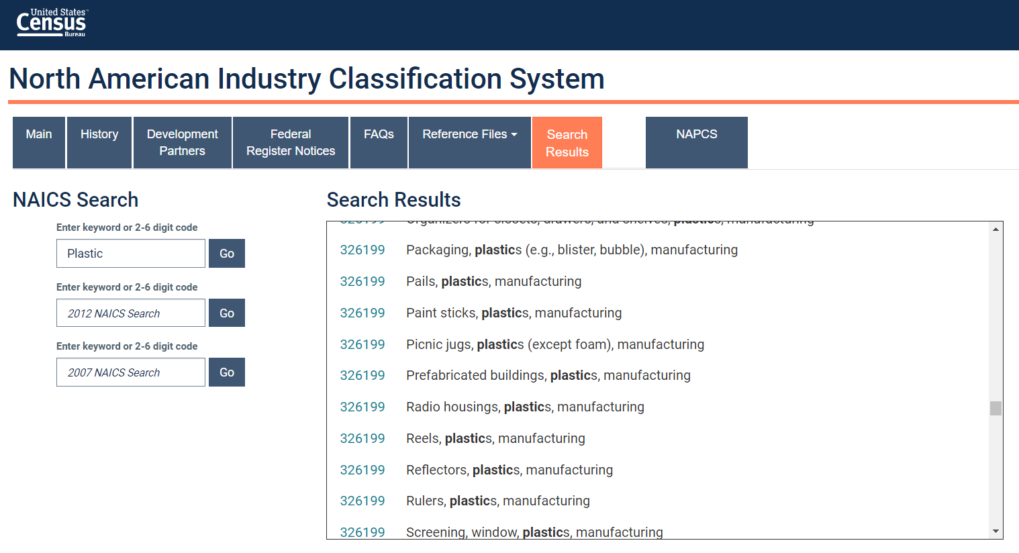
Select the Industry Code Based on the Supplier’s Business and Product
Step 1
Go to:
Conduct a word search to find possible NAICS codes for the product
Select the NAICS code with the best match and record for later use
https://www.census.gov/naics/
Tip: click on the code to view its full definition

Slide 3
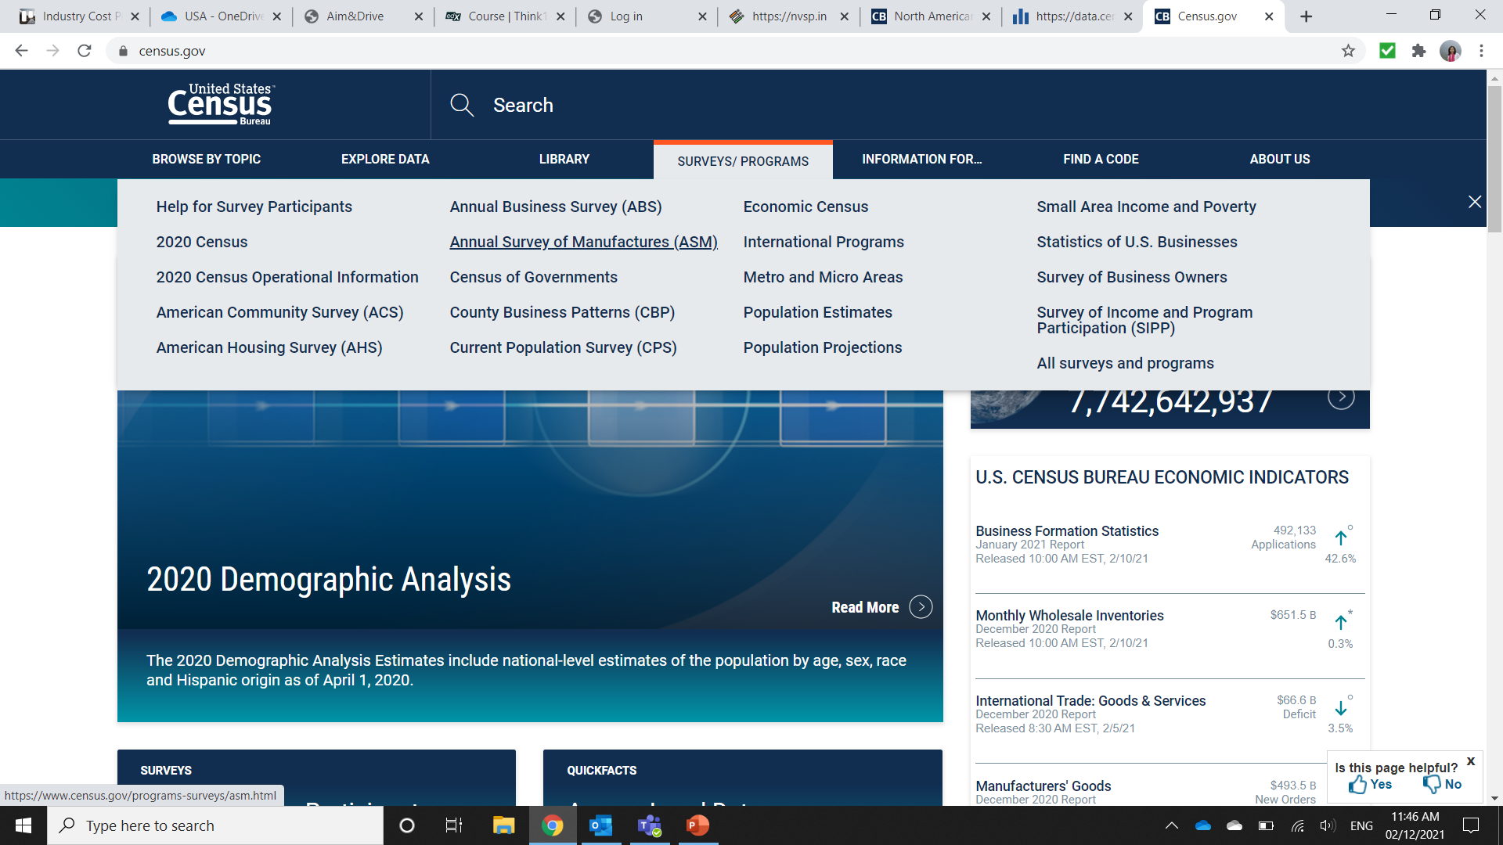
Obtain the latest available Manufacturing Data from the US Bureau of Census for the industry of interest
Step 2
Go to:
Click on Surveys/Programs
Click on Annual Survey of Manufacturers
https://www.census.gov/
*Annual Survey of Manufactures is available in the years that the Economic Census is not conducted. Select Economic Census Industry Series if this is the latest information available.

Slide 4
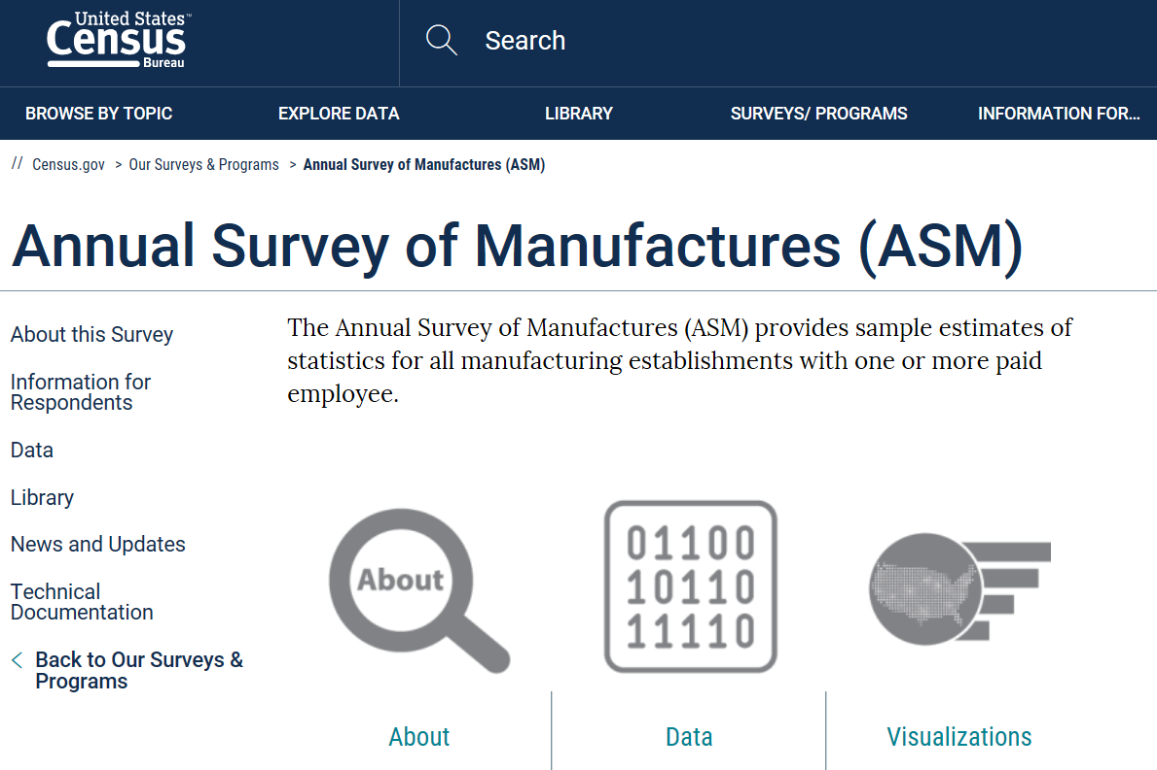
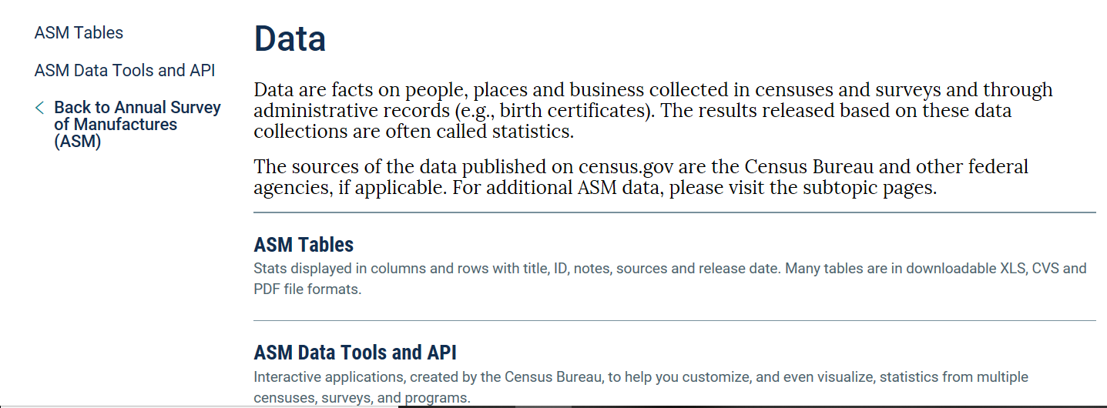
Obtain the latest available Manufacturing Data from the US Bureau of Census for the industry of interest
Step 2
Click on Data
Click on ASM Tables
Click on latest ASM tables, in this case: 2018 Annual Survey of Manufacturers: Tables

Slide 5
Obtain the latest available Manufacturing Data from the US Bureau of Census for the industry of interest
Step 2
Click on Customize Table
Click on 123

Slide 6
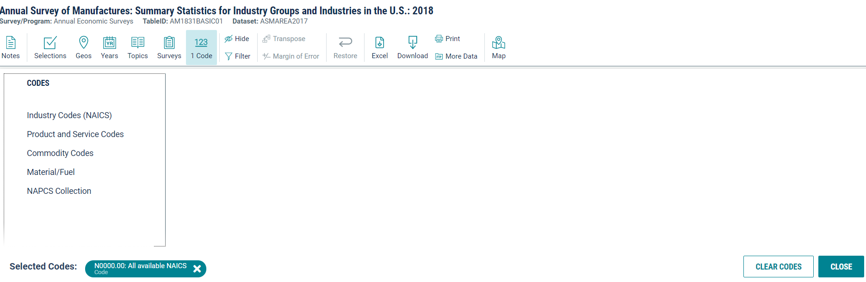
Obtain the latest available Manufacturing Data from the US Bureau of Census for the industry of interest
Step 2
Clear existing selections
Make the following selections:
Industry Codes (NAICS)
31-33 Manufacturing
326 – Plastics and rubber products manufacturing
3261 – Plastics product manufacturing
32619 – Other plastics product manufacturing
326199 – All other plastics product manufacturing
326199 – All other plastics product manufacturing
Click on Close

Slide 7
Record the values of Annual payroll and Production workers annual wages
Step 3
Download the data in an excel if required, or,
Note the following values:
Annual Payroll($1000)
- Production and/or development and exploration workers annual wages ($1000)

Slide 8
Calculate the Direct-to-Total Labor ratio for the industry
Step 4
Calculate the Direct Labor to Total Labor ratio as:
 | Production workers annual wages | 10,813,972
 | Annual payroll | 17,287,408
 | Direct-to-Total Labor ratio | 62.55%
DL/TL= (Production workers annual wages/Annual payroll)

Slide 9
Tip
Use the U.S. Direct-to-Total Labor ratio as a proxy ratio when building an Industry Cost Profile for a country where only information for Total Wages is available.

